Slide 1
Micro Front Ends : Divided We Rule (For Those Who Dream Big)
Parth Ghiya
Notes:
Increase Agility: The speed and response of your business to meet demand or customer need is substantially improved – allowing you to beat the competition at almost every turn.
Improved Decision Making: Access to key, important information – quickly and simply – ensures that you have the right data to make the best decisions no matter where it is in the organization or across your value chain.
Shrinking Distances and Time: You can utilize the very best minds, skills, and experience – irrespective of location; you can create a truly 24/7 presence to your customer.

Slide 2






About Me
Associate Senior Consultant and Practice Lead @ KNOWARTH
Technocrat / Developer / Trainer / Author / Reviewer / Traveler And an immense Foodie… ;)
Author of Typescript Microservices
Reviewed Books :
Building Web Apps with Spring 5 and Angular 4 and Hands-On TypeScript for C# and .NET Core Developers
ghiya.parth
parthghiya
parth.ghiya@knowarth.com

Slide 3

Agenda For The Day
Traditional Monolithic Application
From Monolith to Micro frontends
What is A Microfrontend ?
Tao Of MicroFrontends
Problems it solves,
Advantages, FAQ's and Disadvantages
Microfront Design considerations
How to Split Apps ?
How Apps Communicate and MPA's
Technical Implementations
Angular Elements
Frint

Slide 4
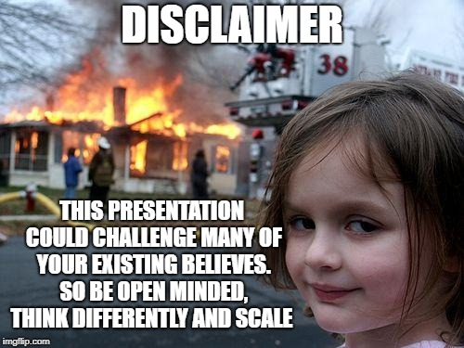

Slide 5









Technology Evolves Quickly

Slide 6
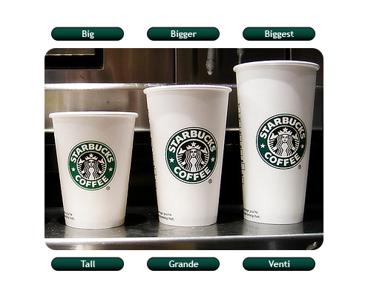
Front End Development Gets Bigger Big exponentially

Slide 7


Traditional Approach

Slide 8
Things that Matter
Look and feel and state of art Design
Customer is God - User Experience
Speed to market - Deliverables have to be speedy, have to be quick, have to evolve
ROI - Return of Investment needs to be there
Developer Happiness - Not get frustrated through constant changes & Deployment
Maintainable Architecture- tedious todo things from scratch incase something fails
Code Portability - Things evolve rapidly, so should code.

Slide 9
What we do in Front Ends ?
Design Systems - Develop multiple features across multiple platforms
Isomorphic Systems - Javascript rendered on backend
Shared Codebases - Component library, multiple teams, multiple platforms
Seperation of Concerns - Services seperated out, easy to migrate
Unit Testing - Much much needed
State Management - Seperate out what application is doing from UI Logic. (Thanks to Facebook)
Immutability -Core Javascript Principle we use in day to day life.
Different ways to handle Asynchronous behavior - Async/await, observables, promises, etc.

Slide 10

My Amazing Application

Slide 11

After 4 months and Some Releases
Dude what is this !!!
I fix one bug - 12 other bugs open up !!
New Feature Again ??? Let me add more code and patches
What will break if i add this code ?
I am in Deep Deep Mess !!!!!!!!!!
Developer Frustration
Customer Frustration
Was initial Framework the right choice ?
Loss - Loss
Upgrade Process is a mess
React vs Vue Vs Angular Upgrade ???

Slide 12

From Monolithic to Microfrontends

Slide 13
Issues and Problems Faced
Monolith not a bad choice unless you can't adopt the change.
Time to market
Scaling and deploying our Applications
Rapid pace of change in JS Vs Rapid pace of customer's demands.
Lots of build scripts to write to make bundle size less.
The bundle size keeps on increasing
Code doesn't become modular
Things are falling apart - A bad apple rots other apples.

Slide 14
Issues and Problems Faced
Dependency management issue: Some 3rd party libraries not updated, hence the whole build fails
Server render blocks requests causing indefinite delays
Serving uncompressed web assets and unoptimized images
Questions Questions everywhere

Slide 15

New Request ?

Slide 16


Slide 17



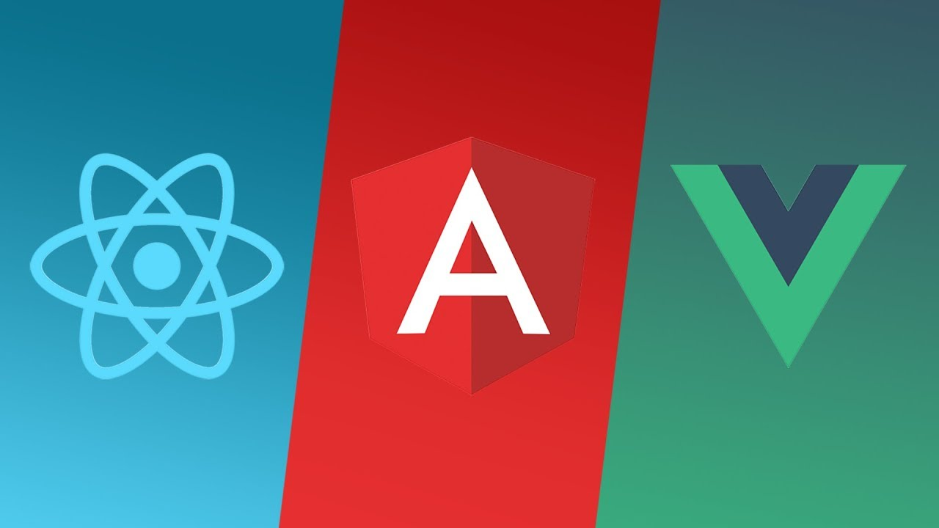

So What Happened ?
Cross Functional Teams
Single Framework Approach
Single thing broke entire application : My state broke
Interdependecies and no independence among team: Long process and frustrated developers
With what to go ahead ?
Do I need Change ?

Slide 18
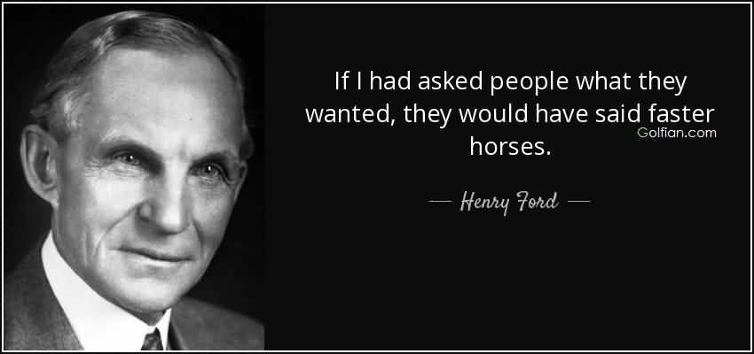
What we want ?

Slide 19
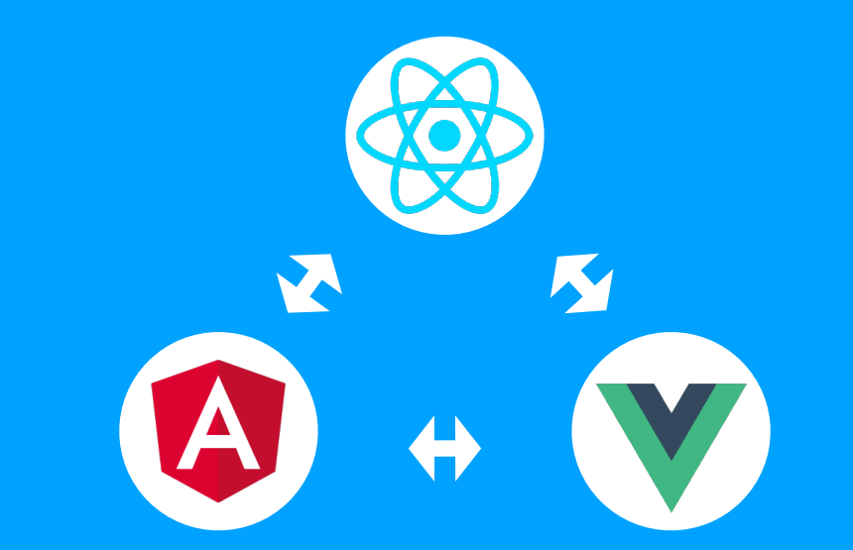
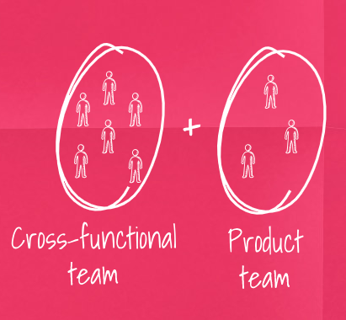
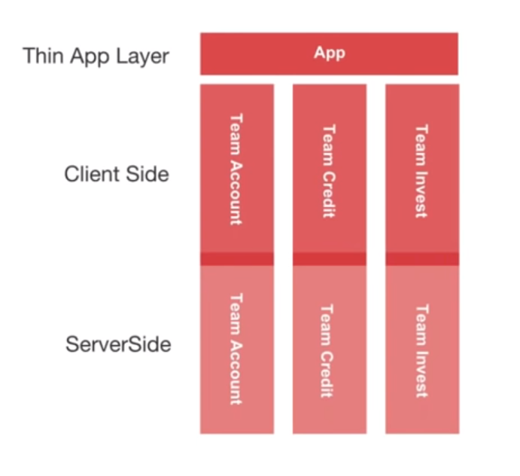

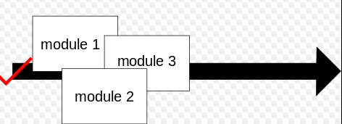
What we want ?
Technological Independence
Independent Teams
Finely Grained Independent Architecture
Independent Loading and deployments
Quicker Deployments

Slide 20


I present to you
Microfrontends - Where frameworks CoExist
Team isolation and Divided we rule
Principle : First do it independent, Then do it better,Then do it Right

Slide 21

What is Microfrontend ?

Slide 22

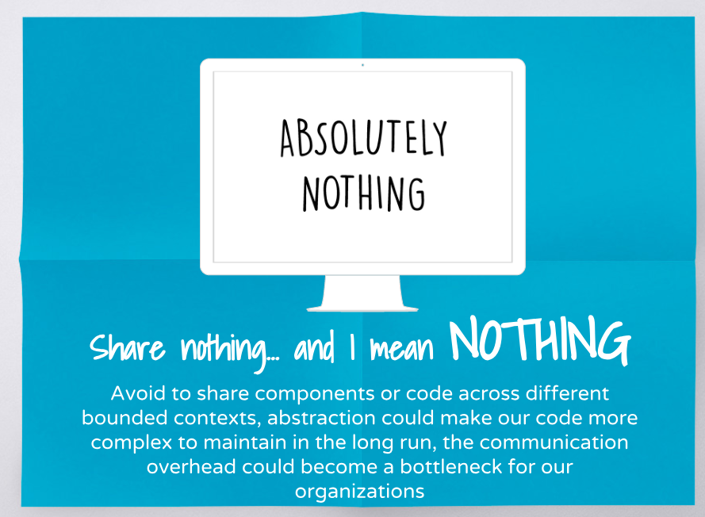

What is Microfrontend ?
Definition from Domain Driven Designing “Microfrontends are technical repredentation of a business domain which provides strong boundaries with clear contracts and also they avoid sharing logic with other subdomains”

Slide 23
Common Terms
Domain :- Any problem to be addressed within the software.
Subdomain:- Decomposition of domains which typically reflect some organizational structure.
Example: Video Streaming Options
Application :- Something which can stand on its own, and it makes sense
Component:- A part of the application but it doesn't make any justification on its own. For example: a datepicker.
Region:- Part where application gets loaded
Code Splitting:- In enterprise application not everything needs to be loaded at first. To serve them on demand basis we do code splitting.

Slide 24
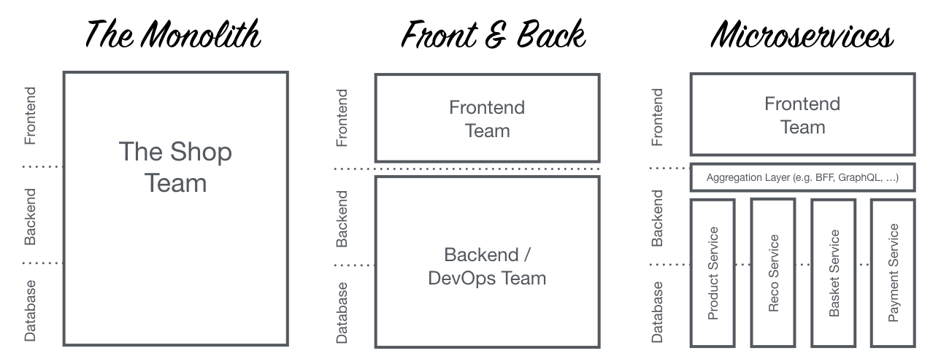
So how do Micro-frontends fit the deck
VS

Slide 25
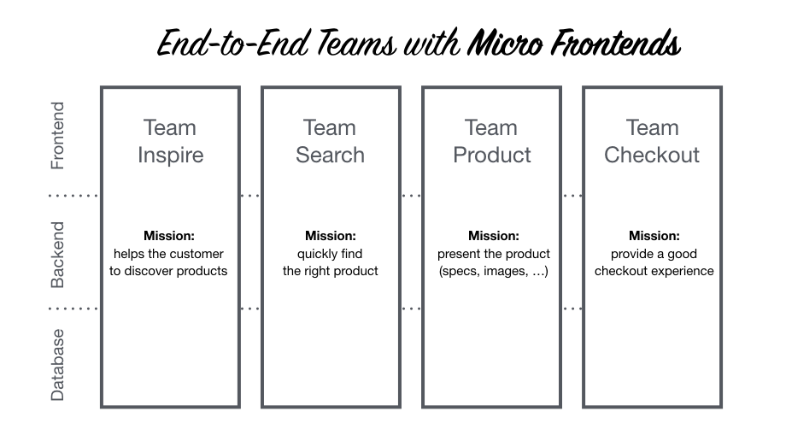
So how do Micro-frontends fit the deck

Slide 26

Tao Of MicrofrontEnds

Slide 27

When Microfrontends ?
If you have doubts :- always stick to the monolithic Application
If you have distributed teams: with tremendous needs of independent releases without impacting many things
Your backend is dividied into microservices also.
Once we go ahead with microfrontends, then its no longer a sprint, its a marathon.

Slide 28
Advantages
Styling is isolated from other Microservices clients due to Shadow DOM or View Emulation feature of React/Angular.
Separate Development and separate deployment (deployment!= main release)
Mixing Widgets and Technologies
Shell can be single page / mixture of single pages / rendered on the server side.
Frameworks Marrying and living happily in their bounded context.
Leveraging the best of Everything

Slide 29
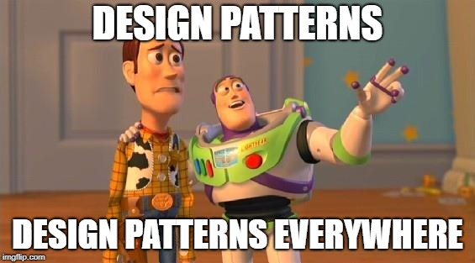
MicrofrontEnds Design Considerations

Slide 30

Common Challenges
Composing multiple frontends – Language Diversity
Sharing data between Multiple frontends
Bounded UX among various frontends
Routing and navigating among various apps

Slide 31
How to Split Apps ?
A functionality on the page
Apps And Components : Apps don't depend on others to survive wheras a component can work within the Application and it doesn't make sense for a component to live by itself.
By Page (Multi Page Applications)
By Section

Slide 32
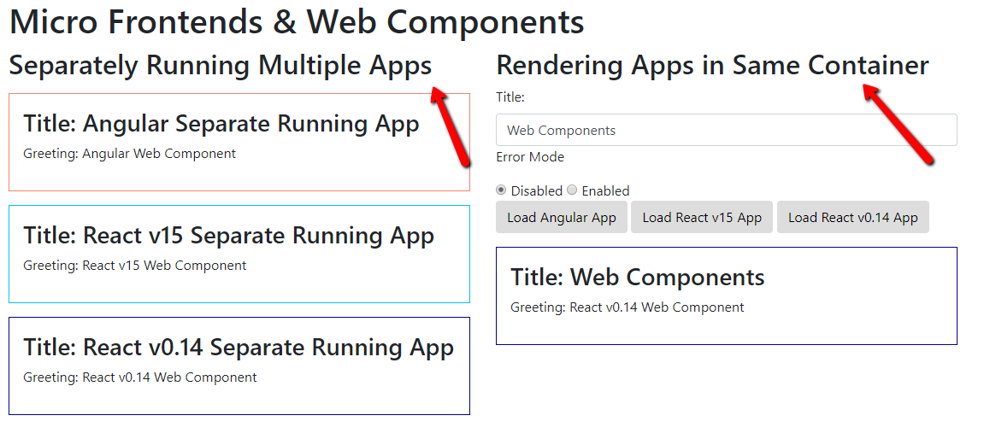
Web components and custom elements

Slide 33
Web components and custom elements
Stateless components
Components can be allowed customization at runtime and render according to the state
React and Vue had those, Angular introduced in version 6.X
Welcome Polymer 3.X (Ionic moving towards polymer components)
Has all lifecycle methods
connectedCallback
disconnectedCallback
attributeChangedCallback
Shadow DOM Vs Real DOM

Slide 34
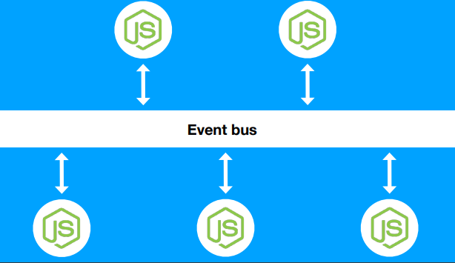
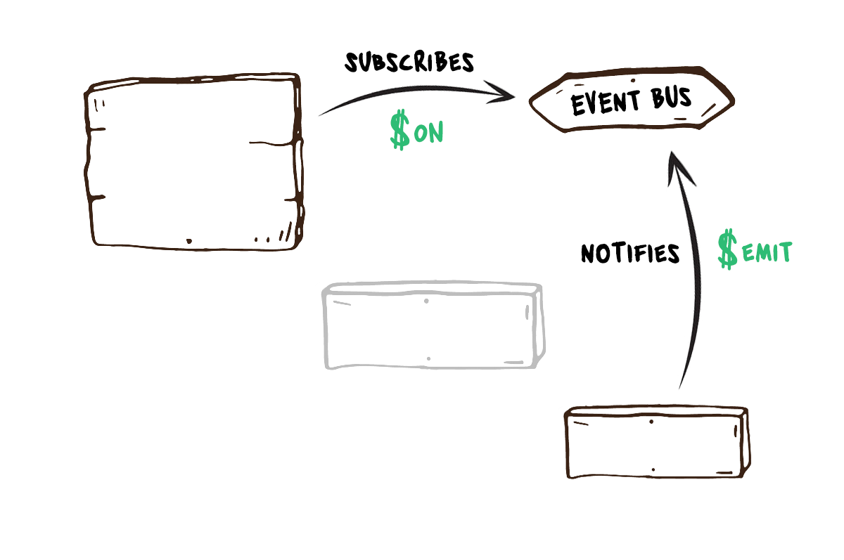
Communication Patterns
This allows publish subscribe style communication between components thusby removing dependecy for components to explicitly register with one another.
Event Bus : communicate via browser events

Slide 35
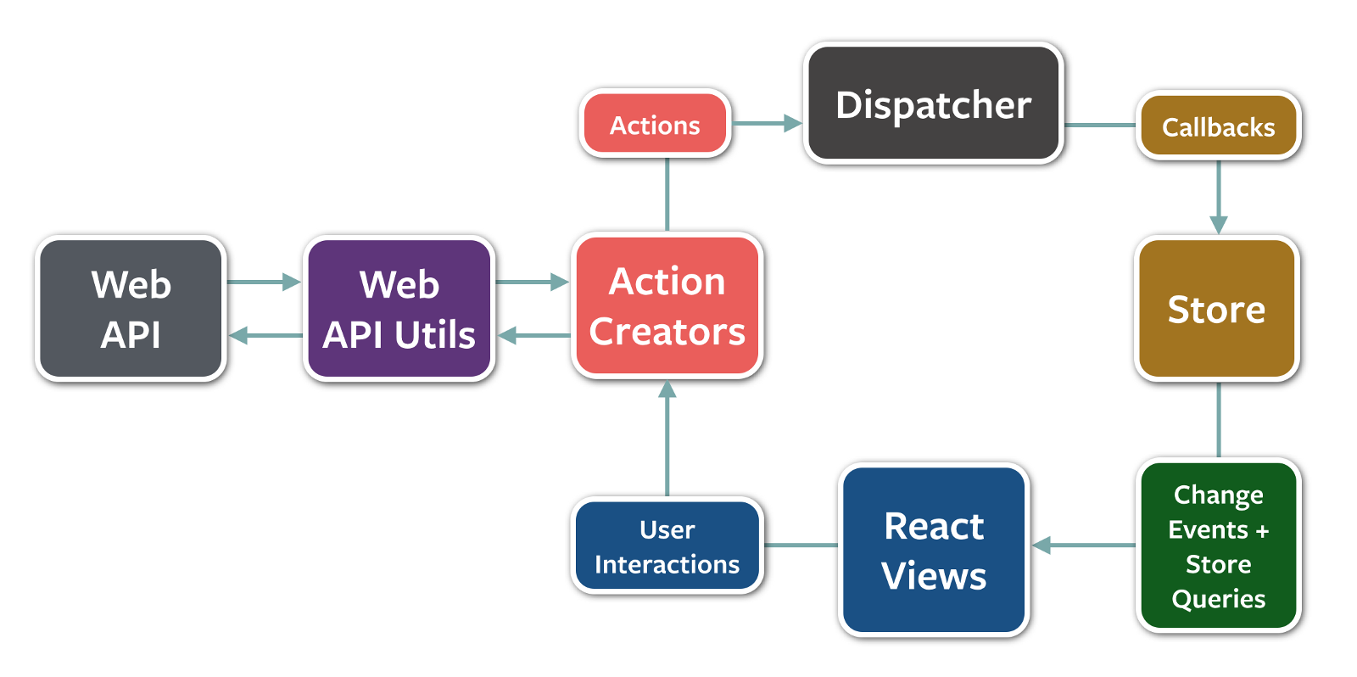
How ?
Web components being normal HTML elements, we can just use attributes.
For instance in Angular we can intensively use @Input, @Output and @EventEmitter
We have a property state which the shell can use to send down some application wise logic.
State is nothing but the central store and single point of truth. Every interaction should be occurring through the state.
We use Observable Programming, where some one emits a message and there are observers waiting to do some action on that.

Slide 36
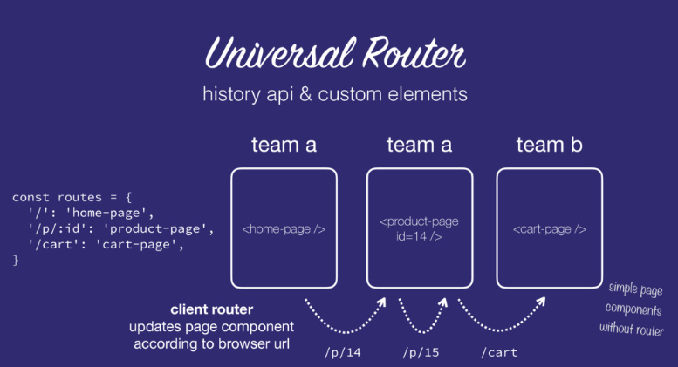
Routing and MPA's

Slide 37
How ?
Webpack : the most famous build tool in discussion
It provides us ability to bundle up entire angular module including CSS, HTML as a single standalone JS file.
A resulting elements.gz.js file in angular compressed through webpack weighs only 62 KB !!
Using DOM Encapsulation – Our CSS will not leak out.
Server side rendering + Universal router + Multiple Page Applications. Wow !!!
Pre-rendered Java script from server helps in faster page load.
Need to use Hash based routing so each microapp can update their route. The onPush approach doesn’t fit here.
Github Link: https://github.com/kriasoft/universal-router

Slide 38


Slide 39
Warning
Warning
DON’T DO MICROSERVICES OR MICROFORNTENDS
IF YOU HAVEN’T
SUCCESSFULLY BUILD A MONOLITH

Slide 40

Why we need Framework or custom solution ?
Iframes are too old and too pesky
Flexibility
Serverless architecture with options of E2E
Mixed Technology Stack
AJAX Takes too much time to load and doesn't utilize the concept of Isomorphic JavaScript

Slide 41
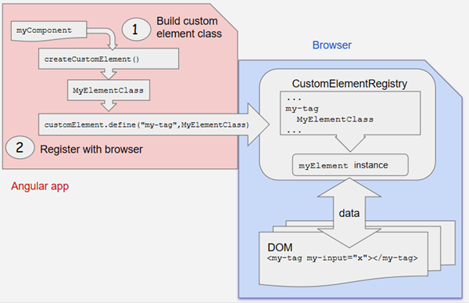
Option#1 Angular Elements based on custom elements

Slide 42
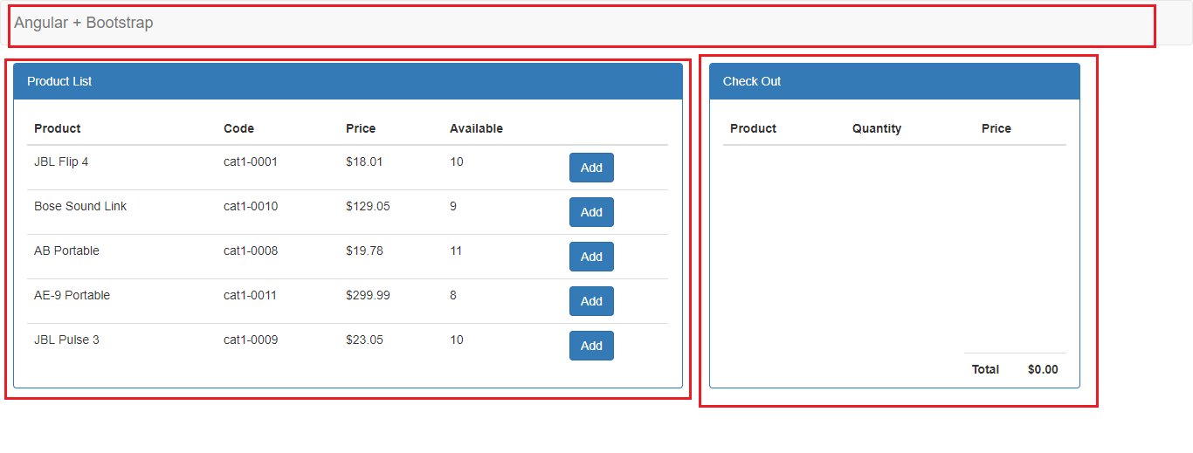
Example In Action

Slide 43
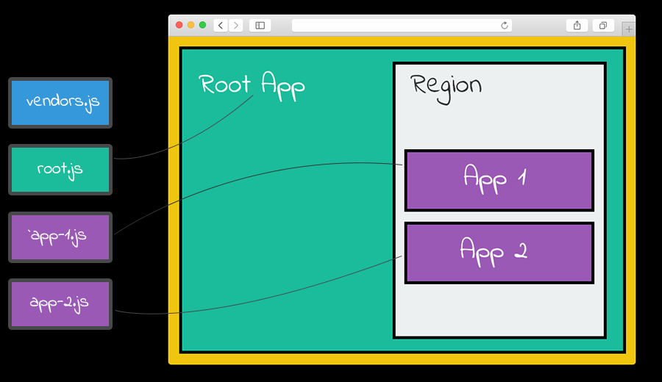
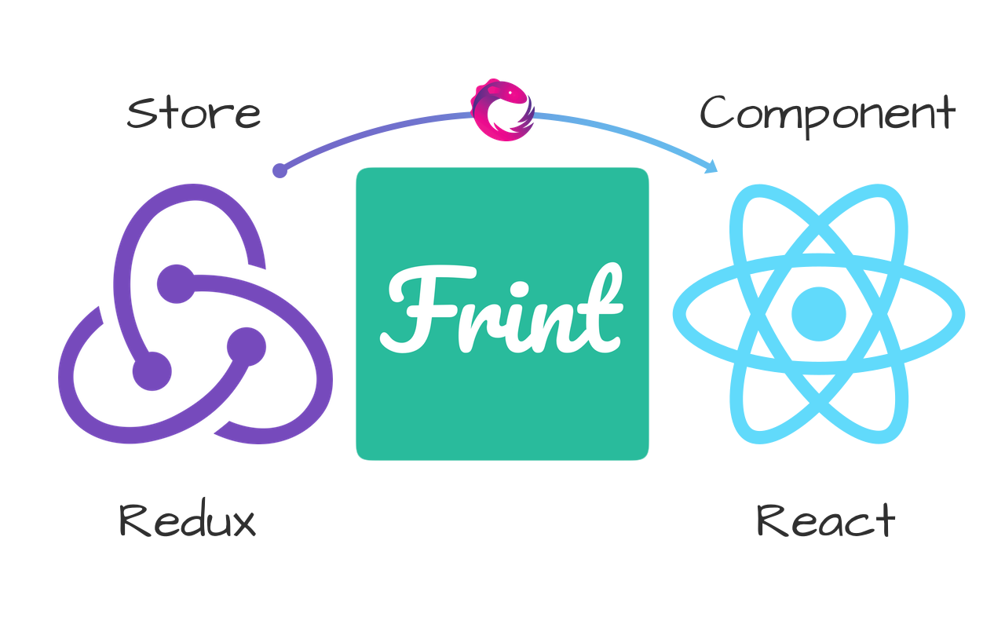
Option#2 Frint (https://frint.js.org/)

Slide 44
Why Frint ?
Align Development across all teams and Support for Backward Compatibility
Everyone builds Apps their way with standards
Gives us control over what we allow and NOT allow to external developers
Open source and maintained documentation and Code Splitting OOB
Has lots of packages including
frint
frint-react
frint-react-server
frint-store
frint-model
frint-router and frint-router-react

Slide 45

Questions

Slide 46

THANK YOU
KNOWARTH Technologies Pvt. Ltd.
INDIA: 11, Aryan Corporate Park, Nr. Shilaj Railway Crossing, Thaltej, Ahmedabad – 380059, Gujarat, INDIA USA: One Commerce Center, 1201 Orange Street #600, Wilmington, DE – 19899
Email: marketing@knowarth.com | Website: www.knowarth.com

